Slide 1

British Airways
Model Result of predicting customer buying behaviour
Hriday Shah

Slide 2
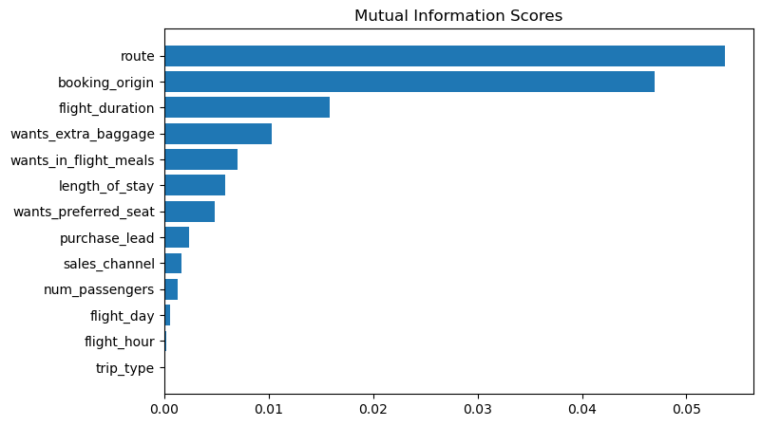
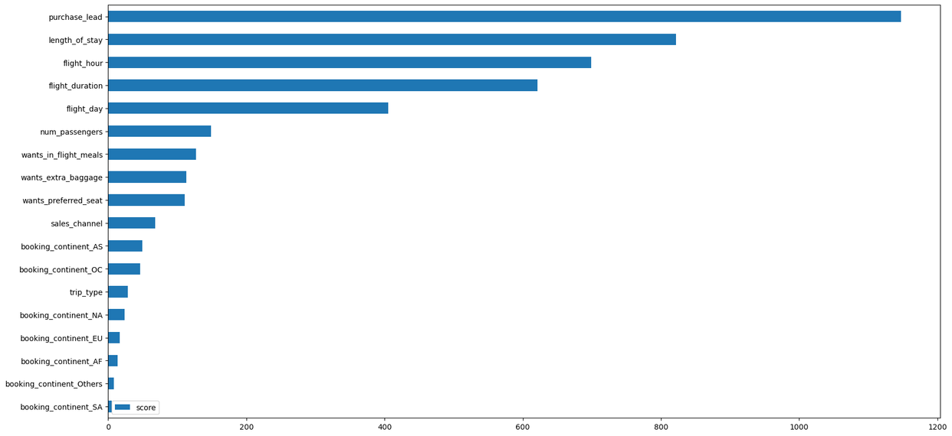
From our feature importance from our model, we know that the influencing factors for customers to complete their bookings are purchase_lead (namely the time gap between the order time and the flight) and length_of_stay (namely how long the customer will occupy the destination). Then the area where the customer orders does not affect whether the customer will complete the booking or not
ACCURACY: 85.09
AUC score: 0.558
1.route
2.booking_origin
3.flight_duration
4.wants_extra_baggage
5.length_of_stay
are the top 5 features which influence
Customer buying behavior

